Slide 1
Basic Syntax & Data Types
Fundamentals of Python Programming Chapter 2

Slide 2
Chapter Content
First Python Program: ‘‘Hello World’’
Indentation
Comment lines
Variables
Data Types

Slide 3

First Program, ‘‘Hello World’’
It’s simple as:
»» print(‘‘Hello World’’)

Slide 4
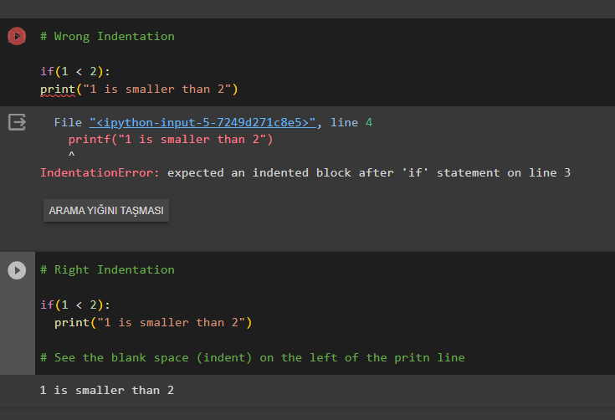
Indentation
Python is indent sensitive.Thus, Identation is pivotal for pyhton programming, for it uses indents (blank spaces) to establish connection in command blocks(like if statements, loops etc.)

Slide 5
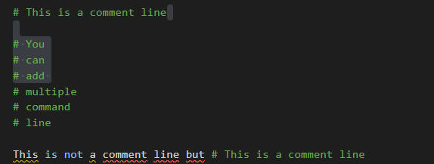
Comment Lines
Comment Lines are used for storing parts that they don't store as a code inside code block, such as explanations, notes etc.Using "#" symbol allows developer to convert the line after the symbol into a comment line

Slide 6
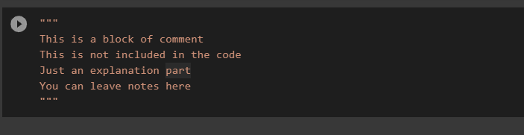
Comment Lines
You can also use """ """ notation to convert a block of code into a comment line

Slide 7
Variables
Variables are containers for storing data values.
Creating Variables
Python has no command for declaring a variable.
A variable is created the moment you first assign a value to it.

Slide 8
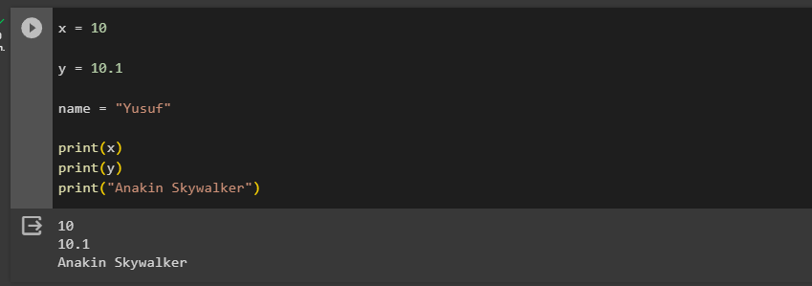
Variables

Slide 9
Variable Names
A variable can have a short name (like x and y) or a more descriptive name (age, carname, total_volume). Rules for Python variables:A variable name must start with a letter or the underscore character
A variable name cannot start with a number
A variable name can only contain alpha-numeric characters and underscores (A-z, 0-9, and _ )
Variable names are case-sensitive (age, Age and AGE are three different variables)
A variable name cannot be any of the Python keywords.

Slide 10
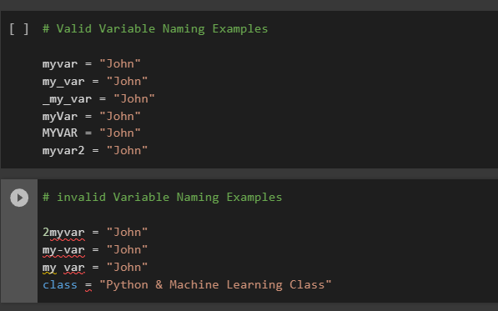
Variable Names

Slide 11
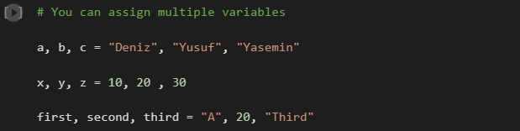
Assigning Multiple Variables

Slide 12
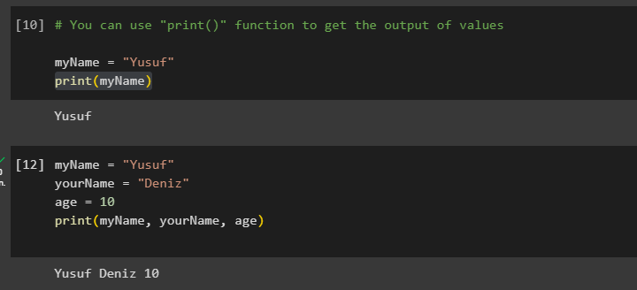
Variables
You can use « print() » to get the values of given variables

Slide 13
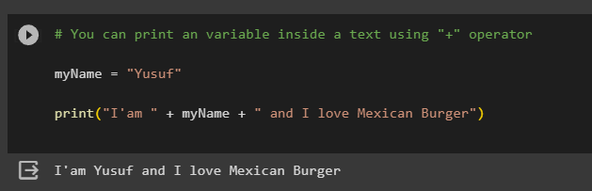
Variables
You can also print a variable inside a text using "+" operator

Slide 14
Data Types
A data type is an attribute associated with a piece of data that tells a computer system how to interpret its value. Understanding data types ensures that data is collected in the preferred format and the value of each property is as expected.
For example, knowing the data type for “Ross, Bob” will help a computer know:whether the data is referring to someone’s full name (“Bob Ross”)or a list of two names (“Bob” and “Ross”)

Slide 15
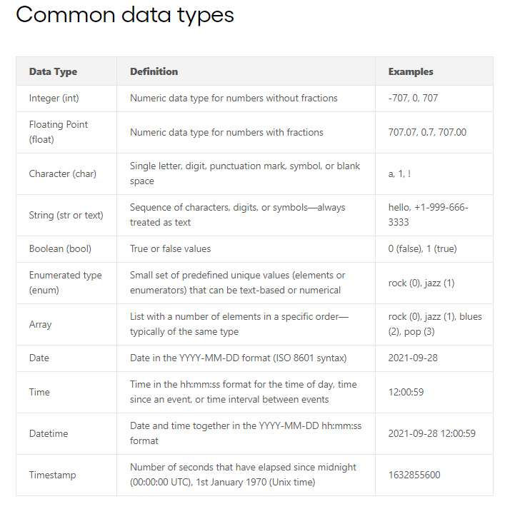
Data Types

Slide 16
REFERENCES
https://www.w3schools.com/python/python_intro.asp
https://amplitude.com/blog/data-typeshttps://www.slideshare.net/RutujaGholap/java-vs-python-250022203

